Slide 1
Registering a systematic review on PROSPERO
Month 2016

Slide 2
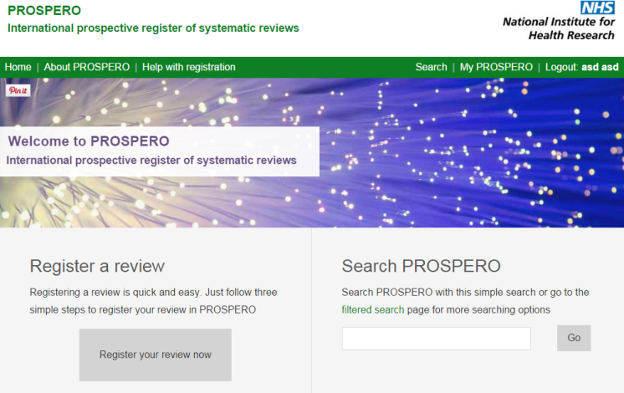
PROSPERO: International prospective register of systematic reviews
Web based
Free to register
Free to search
Users create and update their own records
Minimum data set required
Record content is responsibility of review lead
Administrators check for “sense” not peer review
A public audit trail of amendments is maintained

Slide 3
Registering a review at www.crd.york.ac.uk/PROSPERO
1. Set up a user account/sign in to access all functions
2. Click on ‘Register a review’
Check your review meets the inclusion criteria
Notes:
How to get going.
Signing in gives access to Register a review, My PROSPERO records and My details.
Information given when setting up a user account is used to automatically populate relevant fields in the registration form. We recommend using work details rather than personal details.

Slide 4
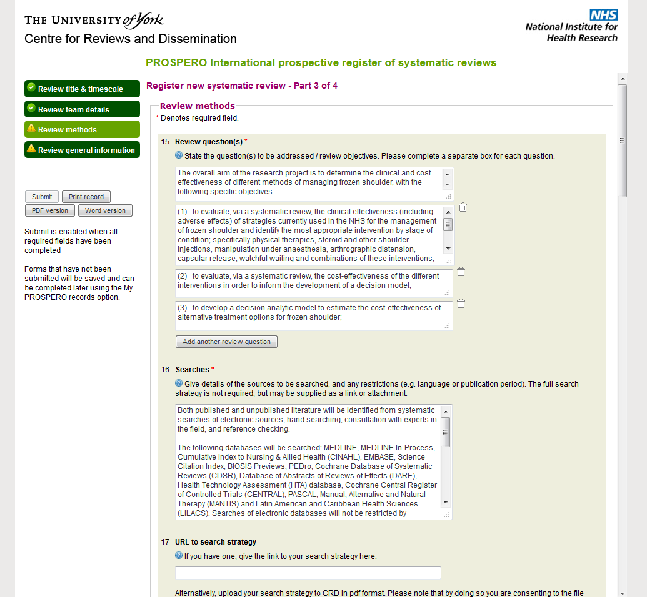
Registering a review
Form has four sections
Review title & timescale
Review team details
Review methods
Review general information
Required fields marked with red asterisk* - these fields must be completed before the ‘submit’ button is enabled
Auto population of fields from user log in details and drop down lists are used where possible
Information can be typed straight in or ‘cut and pasted’
Brief guidance on field content requirements is given above each field, more detailed guidance can be accessed by clicking on the ‘more…’ link
Notes:
Validate this page button shows fields still to be completed.
When you have four green lights – submit enabled

Slide 5
Saving and returning to forms
Information entered in a form field is automatically saved when you click in another field – there is also a ‘Save’ button at the bottom of each page
Forms can be saved as word processing file for sharing with other authors
‘My PROSPERO records’ lists your draft forms and completed registrations for editing at any time
Submitted records cannot be accessed while they are being considered for registration; they become available again once published or released back for clarification

Slide 6
Processing of submissions
An automated email reply confirms a submission has been received
Submission is checked against scope and for completeness and ‘sense’ and a decision made within five working days:
accepted and registration number issued - published on PROSPERO
returned to applicant for clarification
declined (reason given in email)
Published registrations are MeSH indexed by CRD information specialists

Slide 7
Submitting amendments and updates to published records
Major protocol amendments should be recorded
Completion and subsequent publication should be recorded
Access the record, make the changes
Update Field 5: Stage of review at this submission
Update Field 38: Review status
Click submit
Give brief details of the changes made and the reason in the Revision notes facility when prompted
Click submit
All revisions appear in the public record – most recent version is shown and access to previous versions and revision notes given

Slide 8
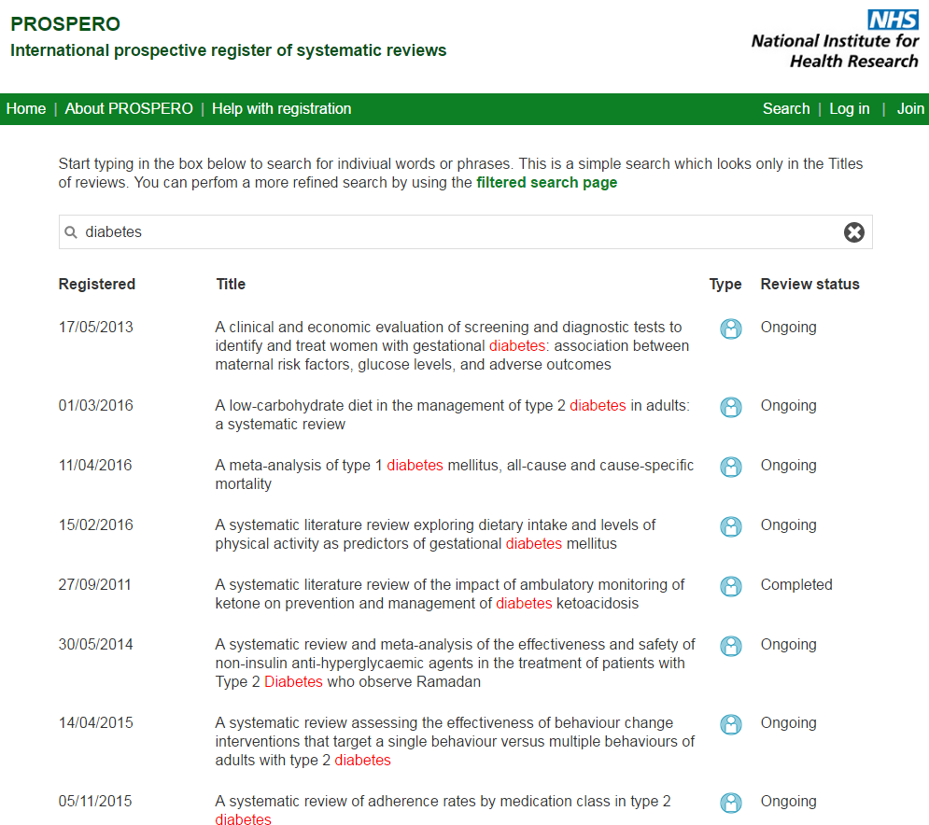
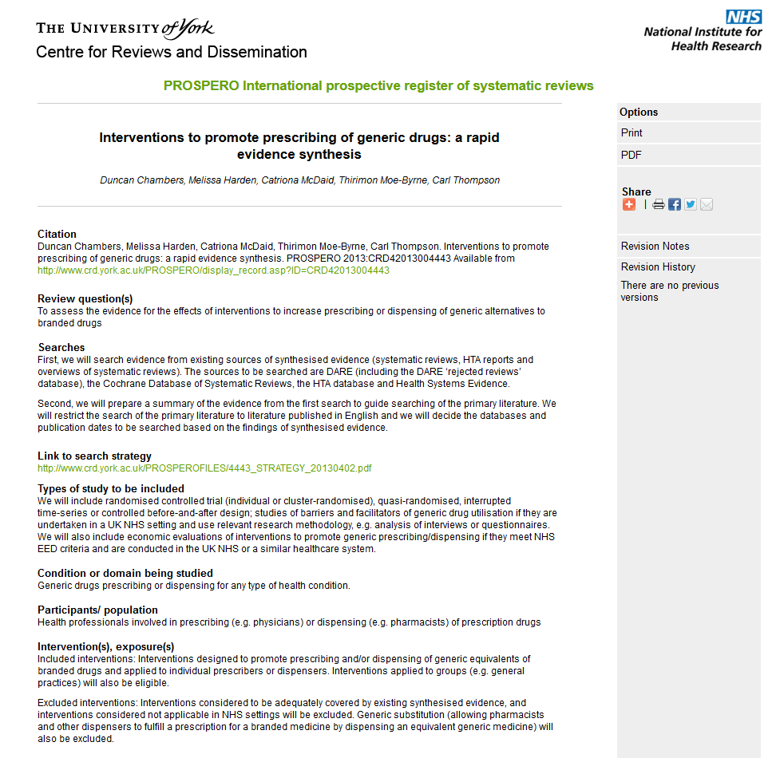
PROSPERO public interface
Published records immediately available on the PROSPERO site
All records are permanent
All records have a unique identification number
Audit trail of major amendments and progress
All versions dated when published on PROSPERO
Records can be printed, saved as a PDF and shared via social media applications

Slide 9
The development and ongoing management of PROSPERO is supported by CRD’s core work programme which is funded by the National Institute for Health Research, England; the Department of Health, Public Health Agency, Northern Ireland and the National Institute for Social Care and Health Research, Welsh Government The views expressed are those of the author(s) and not necessarily those of the NHS, NIHR, Department of Health, or any of CRD’s funders
www.crd.york.ac.uk/PROSPERO

